Slide 1
Quarterly System Entry Capacity
(QSEC)
January 2025
National Gas Transmission

Slide 2
Contents
01 | Introduction
02 | QSEC Auction & Retainer Process
03 | Bidding and Allocation Scenarios
04 | Gemini & Website Overview
05 | Useful Information

Slide 3

Note to Reader
Given the long-term nature of the Quarterly System Entry Capacity (QSEC) auction, National Gas Transmission suggests, whether intending to bid or not, that Shippers take the appropriate steps to familiarise themselves with the auction and its processes before it opens in March 2025.
The information included in this pack is intended to assist potential bidders in this process. However, we strongly recommend that you do not rely solely on the information contained within this presentation.
Thank you.
Capacity Auctions Team
capacityauctions@nationalgas.com

Slide 4
Introduction
01

Slide 5








Fundamentals of the QSEC auction
 | Firm Entry Capacity, sold in quarterly blocks for period Oct 2026 – Sept 2041
 | Max 10 Business Days with interim bid windows
 | Bids can be posted / modified / withdrawn 08:00 to 17:00 daily
 | Auction can close early if prices stabilise
 | National Gas publishes up to 21 price steps per ASEP
 | Shipper’s minimum bid volume ≥ 100,000 kWh
 | Demand-driven price
 | Bids at higher price must have lower or equal volume to those at lower prices

Slide 6


Entry Capacity Auctions – National Gas’ role
What we CAN do:
 | Schedule auctions in accordance with UNC
 | Issue Invitation Letters in accordance with UNC, Licence, Transportation Charges Statement and Entry Capacity Substitution Methodology Statement
 | Allocate / reject bids in accordance with UNC, Licence, Incremental Entry Capacity Release Methodology
 | Publish results via Gemini / National Gas Transmission website
 | Help answer general auction (operational) related queries and provide pointers on things to be considered.
What we CAN’T do:
 | Give advice on bidding strategy

Slide 7


Planning & Advanced Reservation of Capacity Agreement (PARCA)
Click here to access National Gas Transmission’s Capacity Methodology Statements
A PARCA is a bilateral contract that allows you to reserve entry or exit capacity while a project is in development.
More information can be found on our website: https://www.nationalgas.com/our-businesses/reserving-capacity
Impact of PARCAs on QSEC auctions
 | The delivery of incremental capacity is now through PARCA contracts rather than capacity signals
 | Capacity is reserved early in the PARCA process and then allocated once all planning activities have been completed
 | The only incremental capacity which is available through QSEC is that which can be fully met through substitution. Substitution has a lead time of 24 months
 | Non-obligated capacity can still be released if the quantity of capacity requested exceeds the quantity available

Slide 8
QSEC Auction & Retainer Process
02

Slide 9
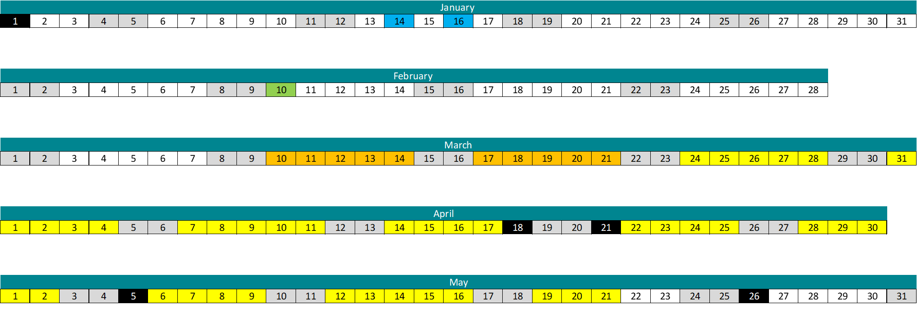
2025 QSEC Auction Calendar
QSEC Retainer Window 1
QSEC Retainer Window 2
QSEC Invitation Letter
QSEC Auction
QSEC Allocation*
QSEC Allocation*
QSEC Allocation*
*Allocation may commence from 12th March if the stability measure is met

Slide 10
Auction Fundamentals
 | Capacity is bid for at specific Entry Points for a daily access right – there is no within day profile.
 | This auction is for a Firm capacity product. The Shipper pays for this capacity regardless of use. National Gas can buy this capacity back if necessary, as part of constraint management arrangements.
 | Capacity offered is in 3-month strips, known as sub-transaction periods (or quarters) and covers Year +2 to Y+16 inclusive
 | The quantity of capacity offered is driven by Licence. Offered quantity is 90% of NTS baseline plus any previously offered unsold Incremental Obligated capacity.
*IECR Applied from here
Mar 2025 | Oct 2026 | Oct 2027 | Sep 2041
2025 QSEC
Transaction Period

Slide 11
Substitution Obligation
National Gas Transmission may undertake substitution processes during the 2025 QSEC auction.
Information regarding this can be found in the Entry Capacity Substitution Methodology Statement (ECS), which is available on the National Gas Transmission website.
Substitution is the process of permanent substitution of unsold baseline capacity from one of more Aggregate System Entry Points (ASEPs) to allow release of incremental capacity at another ASEP.
National Gas Transmission must consider substitution prior to investment as this is deemed an efficient process.
Click here to access National Gas Transmission's Capacity Methodology Statements

Slide 12
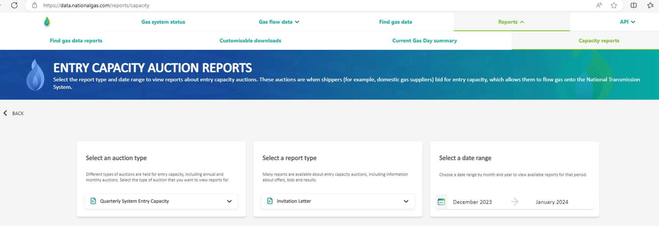
Substitution Methodology – Retainers and Invitations
Users will be able to exclude capacity at potential donor ASEPs from being treated as Substitutable Capacity without having to buy or be allocated the capacity. To do this users are able to take out a ‘retainer’.
Capacity retainers are described in chapter 2 of the Entry Capacity Substitution Methodology. The ECS Methodology also provides a table of Substitutable Capacity (kWh/day) per ASEP,
T&C acceptance proforma, the Retainer application form and Terms and Conditions.
Capacity retainer windows will be open 08:00 to 17:00 on both 14th and 16th January 2025.
Users will be able to submit retainer applications during these windows via email to: capacityauctions@nationalgas.com.
Retainer Invitation Notices are published on the National Gas Transmission website via: https://data.nationalgas.com/reports/capacity

Slide 13
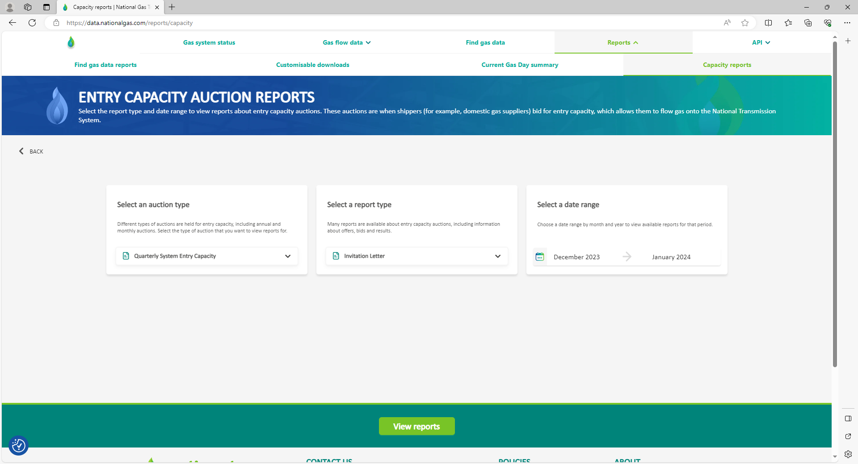
Substitution Methodology – Retainer Invitation
Retainer Invitation Notice published on the National Gas Transmission website via:
https://data.nationalgas.com/reports/capacity

Slide 14
Substitution Methodology – Retention Charges and Refunds
Retention Charges
An NTS Entry Capacity Retention Charge shall apply to any retainer agreement.
In accordance with the Gas Transmission Transportation Charging Statement, a charge rate of 0.2922 p/kWh applies to all granted retainers at all ASEPs.
The retention charge will be payable via an ad-hoc invoice raised within two months of the QSEC auction allocations being confirmed; i.e. in July for a March auction.
Refunds
A retainer is intended to retain capacity at an ASEP for Users to obtain at a later date.
If retained capacity is subsequently booked at the ASEP where the retainer was taken out, the charge may be refunded.
Conversely, in the event that the retained capacity is not obtained later, the charge would not be refunded.

Slide 15
QSEC – UNC Obligations and Invitation Letter
Uniform Network Code Obligations
Prior to the auction date:
    Publish the reserve and incremental prices 60 days before the first day of the auction.
      Published by National Gas Transmission’s Charging & Revenue team. See the ‘Notice of Gas Transmission Transportation Charges’, effective from 1st October 2024.
    Invitation issued 10th February 2025 (28 days before the first day of the auction), which specifies information in line with UNC TPD Section B 2.2.
QSEC auction invitation letter
The dates of the interim bid windows
  The available NTS Entry Capacity for each ASEP (kWh/Day)
  The reserve price for each ASEP (p/kWh/Day) (Appendix A)
  The incremental step prices for each ASEP (p/kWh/Day) (Appendix A)
  Useful resources relating to the Entry Capacity Regime & QSEC Auction

Slide 16
QSEC Bid Capture Rules and Interim Bid Window Process
Bid Capture Rules | Interim Bid Window Processes
Shipper set-up validation (shipper preferences).
Minimum bid quantity of 100,000 kWh.
Bids at a higher price must have lower or equal volume to those made at a lower price.
  Information published after 17:00 each day.
  Aggregate bid quantities at each price step for each quarter and ASEP.
  The prevailing Stability Group for each ASEP/quarter.

Slide 17
QSEC Stability Measure and Price Steps / Quantities
Stability Measure | Price Steps and Quantities
The QSEC auction can close early if Stability Groups remain unchanged between interim bid windows.
If the Stability Group changes 4 times or less between two bid windows at any quarter/ASEP combination, then the auction has reached stability and will close. Users will be notified in this event. (UNC TPD B2.2.17).
Baseline capacity is defined in Licence
Price Step (P₀) - Unsold 90% Baseline + any unsold obligated incremental
      From Transportation Model
  Price Steps (P₁ to P₂₀) – Incremental capacity available
      From Transportation Model
      Up to 150% of baseline capacity
Incremental prices for each (P₁ to P₂₀) are based on the long run incremental cost of providing additional capacity above obligated level

Slide 18
Allocation Rules
Where demand is less than or equal to supply at price step P0, all bids will be allocated in full.
In respect of any ASEP where a quantity of incremental capacity is demanded, National Gas Transmission will determine the Net Present Value (NPV) of the revenue from bids for the incremental capacity, based on the relevant cleared price for each quarter.
If aggregate bids exceed supply volume at a supply level price step, Gemini moves up the demand curve to find the first price step where demand is < = to the supply level. This is the cleared price.
Pro-ration occurs at P20 if aggregate bids at P20 level exceed supply level.
Allocation Exceptions
If the total bid quantity allocated is less than the minimum bid quantity demanded, the bid will be rejected.
If all bids at a price level are rejected due to the above, Gemini moves down a price level and applies the allocation rules again.
The difference between the allocations at the allocation price level and the available capacity at the available supply price level is identified as Unsold Capacity for each ASEP and Sub Transaction Period.

Slide 19
Post Allocation Reporting
National Gas Transmission allocate QSEC bids no later than two months following the date of auction closure, after which we will notify Users (within Gemini) of:
    Accepted quarterly capacity bids
    Amount of Quarterly NTS Entry Capacity which the User is registered as holding
The following information will be published on the National Gas Data Portal and/or Gemini, by Entry Point and Sub Transaction period
  Volume of entry capacity allocated (baseline and incremental)
  The relevant clearing price
  Total amount of revenue to be derived
  Highest price accepted
  Lowest price accepted
  Weighted average price accepted
  The number of users that submitted successful bids
  The amount of obligated capacity which remains unsold

Slide 20
Bidding and Allocation Scenarios
03

Slide 21
QSEC Example 1: Overall demand less than baseline
Price Level | Supply (kWh) | Aggregate Demand (kWh) | Bid (kWh) Shipper A | Bid (kWh) Shipper B | Bid (kWh) Shipper C
P5 | 947,752,500
P4 | 884,569,000
P3 | 821,385,500
P2 | 758,202,000
P1 | 695,018,500
P0 | 631,835,000 | 460,000,000 | 350,000,000 | 50,000,000 | 60,000,000
In this scenario, three bids have been placed.
The total amount, shown as Aggregate Demand in the table, is 460,000,000kWh which is lower than the total baseline supply value at P0, which is 31,865,000. As the demand is lower than the supply, all bids will be allocated in full.
The price paid will also be the P0 price.
National Gas Transmission |

Slide 22
QSEC Example 2: aggregate bids exceed supply until P2
Price Level | Supply (kWh) | Aggregate Demand (kWh) | Bid (kWh) Shipper A | Bid (kWh) Shipper B | Bid (kWh) Shipper C
P5 | 126,000,000
P4 | 117,000,000
P3 | 108,000,000
P2 | 99,000,000 | 75,000,000 | 60,000,000 | 15,000,000 | 1,000
P1 | 90,000,000 | 94,000,000 | 60,000,000 | 25,000,000 | 9,000,000
P0 | 81,000,000 | 100,000,000 | 60,000,000 | 30,000,000 | 10,000,000
In this scenario, the bids cannot be allocated at the P0 or P1 stage because the total demand for all of the shippers is greater than the supply level.
At P2, the aggregate demand is 75,000,000kWh, which is lower than the total supply value of 99,000,000kwh. Therefore, capacity can be allocated at this price step.
Shipper C has only placed a bid for 1,000kWh which does not satisfy the minimum quantity criteria. Therefore, this bid has been rejected.
National Gas Transmission |

Slide 23
QSEC Example 3: aggregate demand exceeds supply at all price steps
Price Level | Supply (kWh) | Aggregate Demand (kWh) | Bid (kWh) Shipper A | Bid (kWh) Shipper B | Bid (kWh) Shipper C
P5 | 102,900,000 | 140,000,000 | 44,100,000 60,000,000 | 36,750,000 50,000,000 | 22,050,000 30,000,000
P4 | 95,550,000 | 140,000,000 | 60,000,000 | 50,000,000 | 30,000,000
P3 | 88,200,000 | 140,000,000 | 60,000,000 | 50,000,000 | 30,000,000
P2 | 80,850,000 | 140,000,000 | 60,000,000 | 50,000,000 | 30,000,000
P1 | 73,500,000 | 140,000,000 | 60,000,000 | 50,000,000 | 30,000,000
P0 | 66,150,000 | 140,000,000 | 60,000,000 | 50,000,000 | 30,000,000
In this scenario, the bids cannot be allocated at the P0 to P4 stages because the total demand for all of the shippers is greater than the supply level.
P5 is the highest price level for this entry point. The aggregate demand is 140,000,000kWh, which is still higher than the total supply value of 102,900,000kwh. Therefore, the capacity needs to be allocated pro-rated at this price level.
The pro-rated amount will be calculated in Gemini e.g. ((bid/140,000,000) x 102,900,000)
The price paid would be the P5 price.
Note: pro-rata will only occur if demand exceeds supply at the highest price step. Pro-rata allocation does not occur at price steps other than the highest.
National Gas Transmission |
Notes:
In this scenario, the bids cannot be allocated at the P0 to P4 stages because the total demand for all of the shippers is greater than the supply level.
P5 is the highest price level for this entry point. The aggregate demand is 140,000,000kWh, which is still higher than the total supply value of 102,900,000kwh. Therefore, the capacity needs to be allocated pro-rated at this price level.
The pro-rated amount will be calculated in Gemini e.g. ((bid/140,000,000) x 102,900,000)
The price paid would be the P5 price.
Note: pro-rata will only occur if demand exceeds supply at the highest price step. Pro-rata allocation does not occur at price steps other than the highest.

Slide 24
QSEC Example 4: aggregate bids exceed supply at P0 - no further bids
Price Level | Supply (kWh) | Aggregate Demand (kWh) | Bid (kWh) Shipper A | Bid (kWh) Shipper B | Bid (kWh) Shipper C
P5 | 202,900,000
P4 | 195,550,000
P3 | 188,200,000
P2 | 180,850,000
P1 | 173,500,000
P0 | 166,150,000 | 180,000,000 | 100,000,000 | 60,000,000 | 20,000,000
In this scenario, the aggregate demand is higher than the supply at P0.
The Shippers place no further bids at any of the higher price steps. Therefore, there is no allocation.
Unless the top price step is reached, allocations are not pro-rata and bids will be rejected.
Under this scenario shippers can review their bids and take the opportunity to bid at higher price steps in the next bid window should they wish to do so.
National Gas Transmission |
Notes:
In this scenario, the aggregate demand is higher than the supply at P0.
The Shippers place no further bids at any of the higher price steps. Therefore, there is no allocation.
Unless the top price step is reached, allocations are not pro-rata and bids will be rejected.
Under this scenario shippers can review their bids and take the opportunity to bid at higher price steps in the next bid window should they wish to do so.

Slide 25
Gemini & Website Overview
04

Slide 26
Gemini Overview of Bid Capture – Bidding Rules
Quarterly Firm NTS Entry Capacity
  Applied/registered by a User for each Day in a particular calendar quarter.
  UNC TPD B2.1.4(a)
User bid must specify
  User ID / BA Code
  ASEP
  Calendar year & quarter
  Amount¹ (kWh/Day)
  Minimum amount¹
  Price level² (Step price i.e. P1) UNC TPD B2.2.6 (a-f)
¹Not less than the minimum eligible amount
²As set out in NG NTS’s Transportation Statement

Slide 27
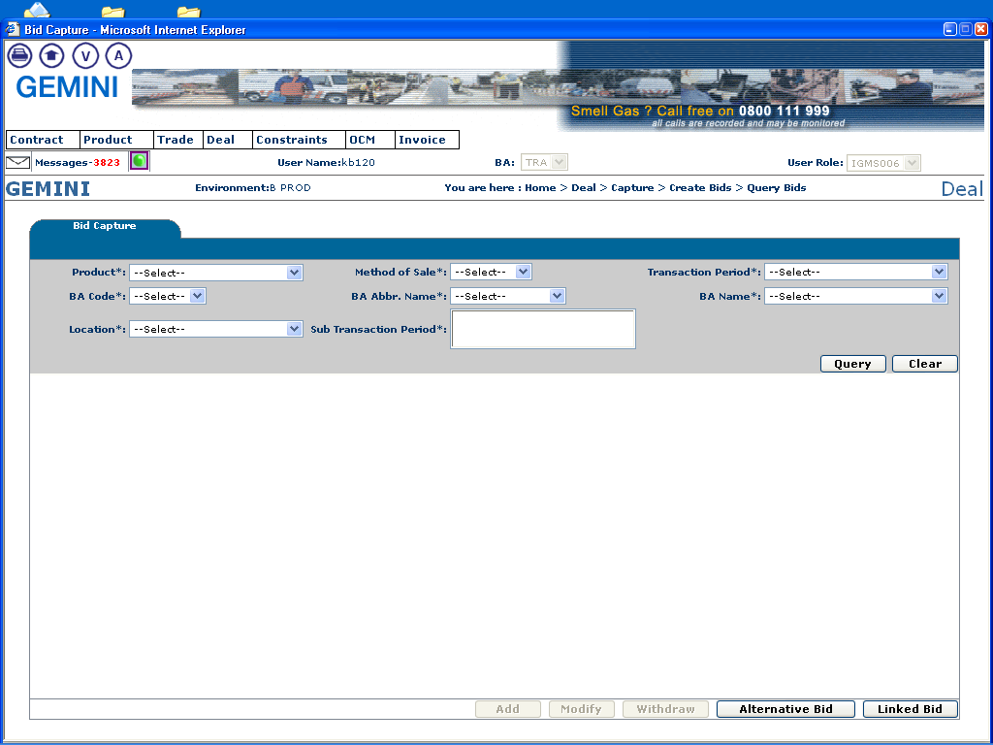
Gemini Overview of Bid Capture – Making a Bid
Home > Deal > Capture > Create Bids
Please ensure that the appropriate product, location and sub-transaction has been selected before entering a bid.
When these fields have been entered Gemini will allow the user to click on this button to add a bid.

Slide 28
Gemini Overview of Bid Capture – Modifying a Bid
Home > Deal > Capture > Create Bids
When these fields have been entered Gemini will allow the user to click on this button to modify a bid.

Slide 29
Gemini Overview of Bid Capture – Withdrawing a Bid
Home > Deal > Capture > Create Bids
When these fields have been entered Gemini will allow the user to click on this button to withdraw a bid.

Slide 30
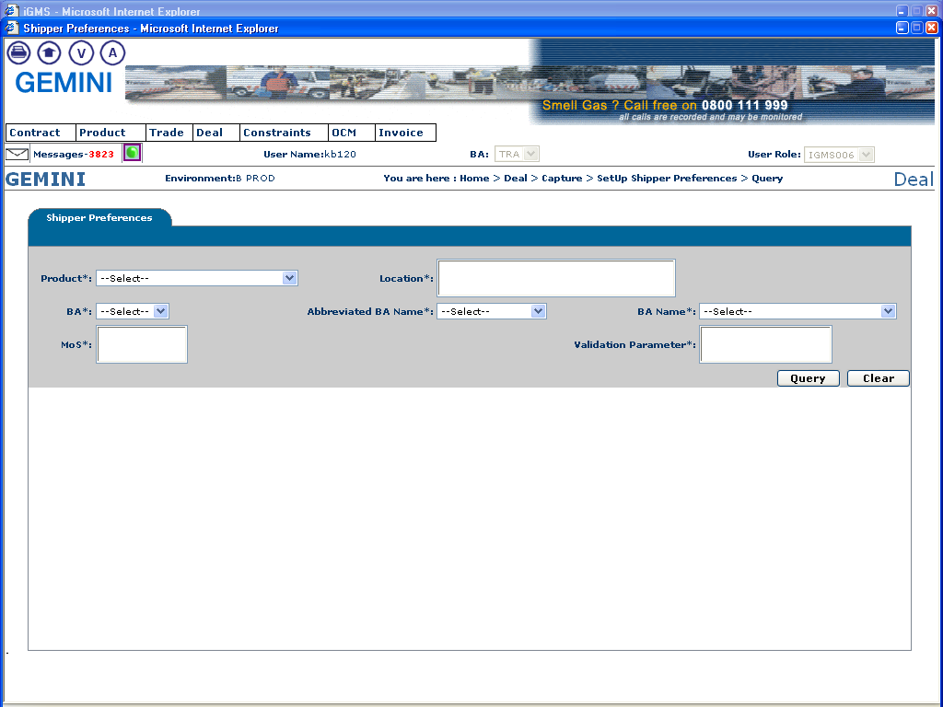
Gemini Overview of Bid Capture – Making a Bid
Home > Deal > Capture > Set Up Shipper Preferences
This allows the user to specify their own validation limits (both upper and lower) for capacity, price and value of a bid. Users should also be able to specify their limits for a combination of methods of sale (i.e. QSEC) and locations (ASEPs).
When these fields have been entered Gemini will allow the user to set or query their own preferences

Slide 31
QSEC Invitation Letter
The QSEC invitation letter is issued:
  Via e-mail
  Via ANS in the form of webfax, email and text
  It is also published on the National Gas website; https://data.nationalgas.com/reports/capacity

Slide 32
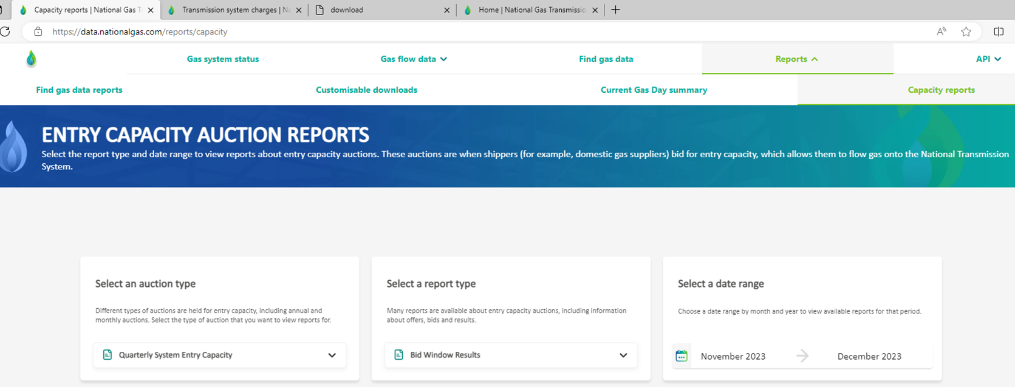
Interim Bid Window (IBW) Results
Gemini
After each IBW, National Gas will notify Gemini Users of the cumulative amounts of Quarterly NTS Entry Capacity allocated, no later than 20:00 hrs. The information will include;
  A User’s submitted Quarterly capacity bids (in aggregate)
  Information for each price step for each relevant Capacity Year.
Website
IBW Reports available in CSV & PDF format via the website at https://data.nationalgas.com/reports/capacity

Slide 33
Allocation Results - Gemini
After allocation, National Gas will notify Gemini Users of the following information by Entry Point and by quarter:
  Volume of entry capacity allocated (baseline and incremental)
  The relevant step price group
  Total amount of revenue to be derived
  Highest price accepted
  Lowest price accepted
  Weighted average price accepted
  The number of users that submitted successful bids
  The amount of obligated capacity which remains unsold

Slide 34

Allocation Results - Website
The allocation results report is available in CSV & PDF format.
  https://data.nationalgas.com/reports/capacity
  Select ‘Quarterly System Entry Capacity’ and ‘Allocation Results’

Slide 35

Long Term Summary Report
The Long Term Summary Report is available in Excel format and is updated after final allocations have been completed.
  https://data.nationalgas.com/reports/capacity
  Select ‘Long Term Summary Report’ and ‘Summary Report’

Slide 36
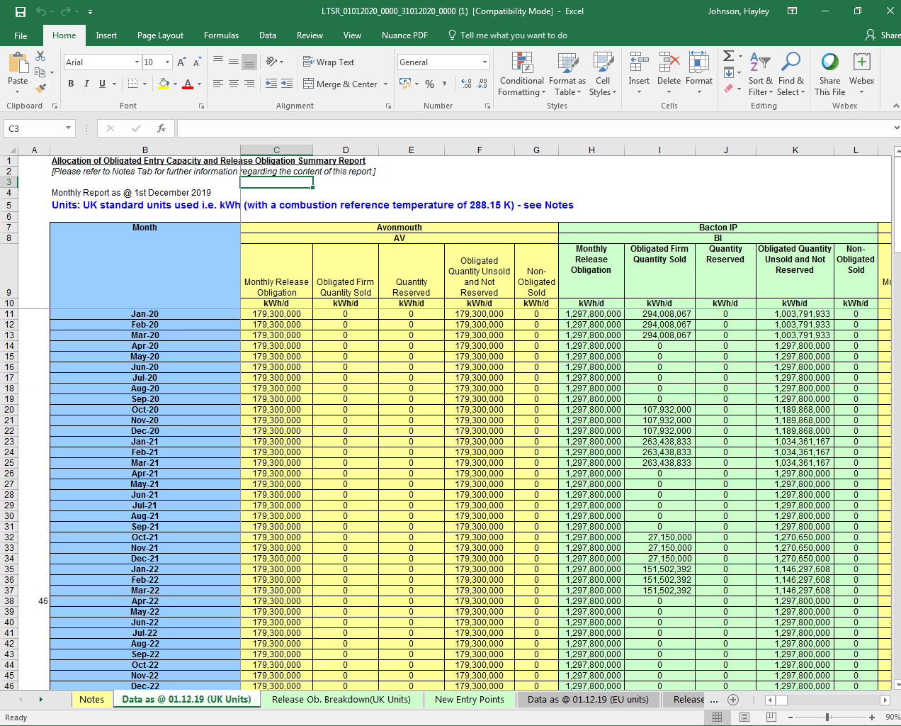
Long Term Summary Report
This report is updated on the first working day of each month and shows the quarterly and monthly NTS Entry Capacity sold and available in the QSEC, AMSEC and RMTNTSEC auctions.

Slide 37
Useful Information
05

Slide 38



Useful Capacity Related Documents
Capacity Frequently Asked Questions
Gas Transmission Capacity Guidelines
Capacity Methodology Statements
A document put together based on the most frequently asked capacity questions.
This guide outlines the gas transmission network’s access capacity purchasing processes that apply from November 2015.
NTS capacity methodology statements required under the Gas Transporter Licence, as well as associated consultations, documents, planned industry workshops and additional supporting details.

Slide 39
Useful Contacts
Company | Contact Details
NTS Capacity Team | Tel: +44 (0)1926 654 057 Email: capacityauctions@nationalgas.com
Corella Customer Lifecycle Team (for Gemini E-Training) | Website: www.xoserve.com (for training specifically: https://www.xoserve.com/systems/gemini/gemini-training-and-understanding/) Email: customerlifecycle.spa@xoserve.com
Joint Office Customer Lifecycle Team (to publish industry information) | UNC mod proposals affecting QSEC auctions QSEC Invitation Letter Website: www.gasgovernance.co.uk Tel: +44(0)121 623 2115

Slide 40
Thank you

