Slide 1
National Grid Gas
RIIO-2 System Operator Incentives
Supporting Information 2021/22
Version 1
October 2022

Slide 2
Contents
Introduction | Page 3
Financial Performance | Page 4
Impact on charges | Page 5
Incentive Scheme Overview | Page 6
Incentive Schemes | Page 8-18
Associated Reading | Page 19
Version Control | Page 20

Slide 3
Introduction
This report provides a summary of the National Grid Gas (NGG) Financial Incentive Schemes and performance for Financial Year 2021/22, this summary has been created to provide greater transparency following feedback received through responses to consultation papers and in industry events.
The 2021/22 incentive arrangements are part of the RIIO2 Framework, the second Transmission price control under Ofgem’s new model of regulation that will run from April 2021 to March 2026. The first framework ran from April 2013 to March 2021. This pack covers Capacity Constraint Management, Demand Forecasting D-1, Residual Balancing, Maintenance and Greenhouse Gas Compressor Emissions incentives.
NGG is subject to licence obligations and several financial and reputational incentive arrangements, outlined in our licence following consultation. These are regularly reported to and monitored by Ofgem.
These incentive arrangements are designed to minimise the overall cost of system operation leading to benefit for consumers, they are designed to influence our behaviour to minimise the impact on the market, to consider environmental impacts and to support the efficient operation of the wholesale gas market.
This annual report is the first of five that will cover the RIIO2 regulatory period.

Slide 4
2021/22 Financial Incentives Performance Summary
Capacity Constraint Management (CCM)
In January 2022, we responded to high forecast and actual LNG flows at Milford Haven and increasing pressures in that part of the network by taking Locational Actions on 10th and 11th Jan 2022. High gas price differentials through to Europe supported additional revenue via release of Non-Obligated capacity. Scaling and Sharing Factors applied with over £5m returned to Shippers.
Demand Forecasting D-1 (DF)
During 2020/21 we invested into new demand forecasting capability models. 2021/22 saw continued refinement and productionising of the models, although constant adaption was required to analysis new supply and demand behaviour relationships as they moved away from historical market norms with the uncertainty and volatility in the global gas markets.
Residual Balancing (RB)
The LPM was better than the target of 2.8 mcm/d on 268 days during the year (73% of days). The PPM element achieved an average price spread of 1.8% of SAP, compared to the 1.5% incentive target. We took residual balancing actions on 252 days (69%) of days 2021/22. Geopolitical events have led to a period of market volatility creating the most volatile commercial period over the last 10 years.
Maintenance (MA)
High number of aligned customer impacting days (161 days), with minimum ‘Maintenance Days’ called and no NGG changes to the agreed maintenance plan. Alignment with customers maintenance plans created over £12.5m of customer benefit.
Greenhouse Gas Compressor Emissions (GHG)
We implemented additional initiatives to support the continued drive to reduce the environmental impact of our compressor operations, including an engine inhibiting trial, part of a wider Maintenance Review, early unit depressurisation decisions and maintenance procedural improvements helped to reduce venting occurrences while maintaining test requirement integrity.
Notes:
Additional revenue via high gas price differentials through to Europe.
Approximately £1.65m revenue for release of Non-Obligated (Entry and Exit). Sharing Factors applied.
Approximately £3.63m revenue from the sale of locational energy in January, following a constraint. Sharing Factors applied.
how about ... The LPM was better than the target of 2.8 mcm/d on 268 days during the year (73% of days). The PPM element achieved an average price spread of 1.8% of SAP, compared to the 1.5% incentive target. The geo-political news led to the a period of market volatility creating the most volatile commercial period over the last 10 years. We took residual balancing actions on 252 days (69%) of days 2020/21.

Slide 5
Incentives Impact on Charges
This section aims to explain the link between incentive revenues and resultant charges faced by Shippers.
Incentive performance outturns are settled via General Non Transmission Services Charges, which NGG update annually every October.
As a rule of thumb, an increase or decrease of £2m in the costs recovered through the General Non Transmission Services Charge would correspond with an increase/decrease in the General Non Transmission Services Charge of approximately 0.0001p/kWh applied to both entry and exit flows.
During RIIO1 where there was a 2 year lag on incentive performance and cost recovery, as the performance was not known for price setting. The RIIO2 Framework allows NGG to forecast incentive performance within the Allowed Revenue and start to collect the that within the performance year, actual incentive outturns will retrospectively adjust to true up forecast within future years General Non Transmission Services Charges.

Slide 6
Incentive Scheme Overview
NGG operates the high-pressure Gas National Transmission System (NTS) in Great Britain and subject to Licence obligations and several financial incentive schemes. These schemes can be seen in the National Grid Gas Plc Gas Transporter Licence in respect of the NTS. Link below.
Incentive Scheme | Status & Design | Duration
Entry Capacity and Exit Capacity Constraint Management | Financial | Set for 5 years
Residual Balancing | Financial | Set for 5 years
Day Ahead Demand Forecasting | Financial | Set for 5 years
Maintenance | Financial | Set for 5 years
Greenhouse Gas Emissions | Financial | Set for 5 years
Demand Forecasting (D-2 to D-5) | Reputational with licence obligation - financial scheme ended in March 2021
NTS Shrinkage | Reputational with licence obligation - financial scheme ended in March 2021 | The Authority may review the licensee's management of NTS Shrinkage in the Regulatory Year commencing on 1 April 2023.
Operating Margins | Reputational with licence obligation - financial scheme ended in April 2013
Data Publication | Reputational with licence obligation - financial scheme ended in April 2013
UAG (Unaccounted for Gas) | Reputational with licence obligation - financial scheme ended in April 2013
https://epr.ofgem.gov.uk/Content/Documents/National%20Grid%20Gas%20Plc%20-%20Special%20Conditions%20Consolidated%20-%20Current%20Version.pdf

Slide 7
Financial Incentive Schemes

Slide 8
Entry Capacity and Exit Capacity Constraint Management (CCM)
Purpose | The CCM Incentive is designed to incentivise NGG to release maximise available capacity on the network and minimise constraint management costs through the efficient and economic operation of the NTS. We therefore release as much capacity as possible, develop effective constraint management strategies and make economic and efficient NTS investment and planning decisions.
Description | In the instances where NGG believes that customers’ flow requirements cannot be accommodated; constraint management actions may be undertaken in accordance with the Uniform Network Code and System Management Principles Statement. These actions fall into two categories: 1. Operational constraint management – actions taken by NGG to manage day to day issues on the network. Examples of such day-to-day issues include mismatching supply and demand patterns, unavailability of compression or maintenance outages; and 2. Investment constraint management – actions taken by NGG to manage longer term issues associated with provision of additional capacity on the network. Examples of such longer-term issues include where physical reinforcement is not delivered within the contracted timescale.
Customer Benefits | This benefits our customers, and ultimately end consumers, as the costs of commercial constraint management actions to the Industry are mitigated or minimised and balanced against NTS investment whilst maximising access to the NTS. A robust CCM incentive drives an effective strategy which delivers value to Industry and end consumers who share in the benefit of strong performance.

Slide 9
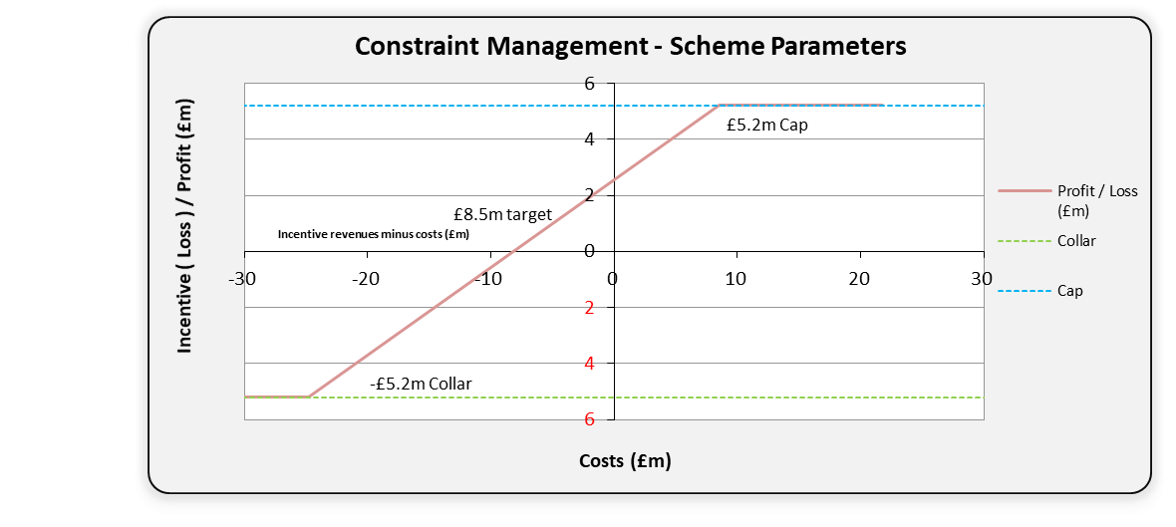
Entry Capacity and Exit Capacity Constraint Management (CCM)
Scheme Parameters | Incentive revenue or penalty based on annual actual net costs being higher or lower than the incentive target and is based on a calculation that incorporates the RIIO-2 “Sharing Factor” which is 39%; the remaining 61% is passed back to Shippers. Target = £8.5m Value = +£5.2m to -£5.2m (14% scaling for revenues from non-obligated capacity sales) Sharing Factor = 39% NGG, 61% Shippers
Description | There are a suite of commercial tools available to manage Capacity constraints, which include but are not limited to: Capacity Scaleback – scaling back in full or in part, the Interruptible Entry Capacity or Off-peak Exit Capacity allocated. Withholding the sale of remaining, unsold firm capacity in the Daily Entry and Exit Auctions. Locational Energy Trades – buying or selling gas at specific locations on the NTS. Capacity Buybacks – buying back sold Firm Entry or Exit Capacity; and Turn-Up/Turn-Down Contracts – contracts to manage longer term forecast constraint risk.

Slide 10
Residual Balancing (RB)
Purpose | In our role as the residual balancer, we may take residual balancing actions to balance supply and demand on the gas day by buying or selling gas through the On the Day Commodity Market (OCM). The residual balancing scheme incentivises us to balance supply and demand on the gas day and to minimise the impact we have on the market when we deem it necessary to trade gas to balance the network. There are two elements to this incentive scheme Price Performance Measure (PPM) Linepack Performance Measure (LPM).
Description | PPM:Evaluates the impact National Grid has on the market in its residual balancing role by measuring the price range of its trading actions compared to the System Average Price (SAP). This incentivises the GSO to minimise the impact it has on market prices. The PPM is the difference between the highest and lowest prices NGG trades, divided by SAP. The target or breakeven point is a price spread of 1.5% of SAP. LPM: Minimise any changes between opening and closing NTS linepack over a Gas Day (i.e. to achieve a balance between the supply and demand on the Gas Day). This is intended to ensure that any system imbalances are resolved on the relevant day, so that the costs of resolving any imbalances are targeted to those responsible for the imbalance. The target or breakeven point is a linepack change of 2.8mcm, with a performance dead band between 2.8 and 5.6 mcm for the months of October, November, February and March.
Benefits | The residual balancing incentive is intrinsic to how we perform the residual balancing role and benefits the end consumer by minimising both our activity in the market and the impact it has on the market prices when it is deemed necessary to trade gas to balance the network.

Slide 11
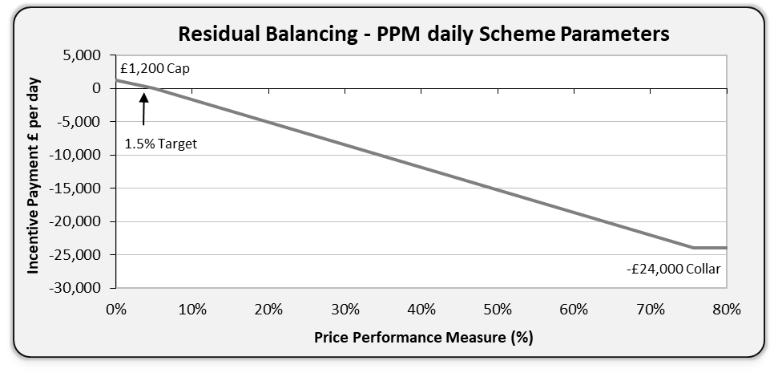
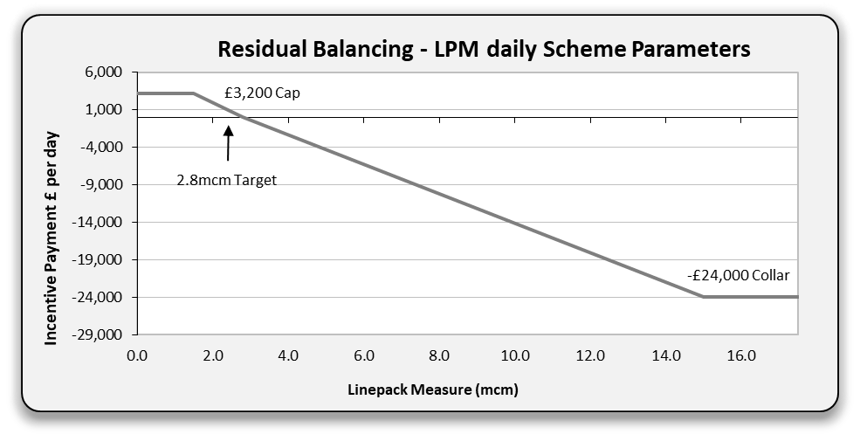
Residual Balancing (RB)
Scheme Parameters | If the PPM is less than 1.5% on a given Gas Day, then NGG receives an incentive payment up to a maximum of £1,200 per day. Conversely if the PPM is above 1.5%, then NGG incurs a penalty up to a maximum of £24,000 per day, which is the penalty for a trading range equal to 76% or more of SAP. If the LPM is less than 2.8mcm on a given Gas Day, then NGG receives an incentive payment up to a maximum of £3,200. This maximum applies at 1.5mcm, so there is no incentive for NGG to balance the system beyond this point. Conversely if the LPM is above 2.8mcm, then NGG incurs a penalty up to a maximum of £24,000. For a single day which is the penalty for linepack movement of more than 15mcm. The sum of all the daily payments for the PPM and LPM under the Residual Balancing incentive are annually capped at £1.6m and collared at £2.8m. The incentive recognises the requirement for linepack stock to be higher in the winter than summer in order to operate the network efficiently. As a result, during the ‘shoulder months’ (October, November, February and March) the incentive provides no revenue or penalty for a daily linepack change of between 2.8mcm and 5.6mcm.

Slide 12
Day ahead Demand Forecasting (DF)
Purpose | NGG are incentivised to publish national gas demand forecasts over a range of timescales to the industry, these forecasts have been subject to an incentive since 2006. These national demand forecasts for day ahead (D-1) and for two to five days ahead (D-2 to D-5, reputational incentive only) are a key tool for the UK gas industry in ensuring the economic balancing of gas supply and demand.
Description | NGG has an incentive breakeven target of an annual weighted average absolute forecast error of 8.35mcm/day. However, there is an adjustment to this target for the level of short-cycle storage injection capability that is designed to consider the unpredictability of demand from short-cycle storage sites. The storage adjustment is capped at an additional 1mcm/day and therefore has the potential to revise the D-1 demand forecasting target to 9.35mcm. If the published demand forecast error is below the breakeven target, an incentive payment will be received, conversely, if the forecast error for any day exceeds the target an incentive penalty will be applied.
Benefits | The provision of timely and accurate forecasts aids efficiency from both a physical and commercial perspective, this should result in reduced operating costs which directly impact on end consumers gas bills. NGG strives to continually optimise its forecasting processes, to deliver greater accuracy and increased consumer benefit.

Slide 13
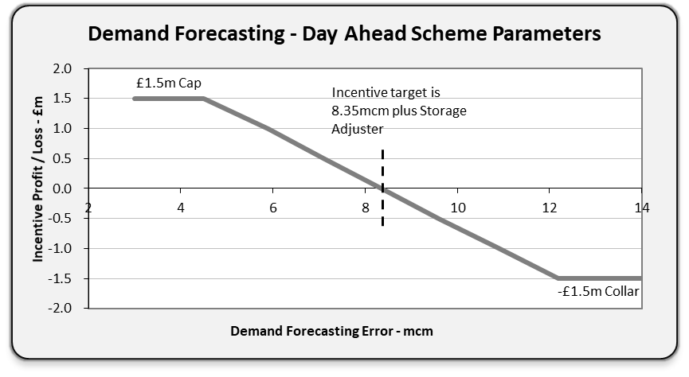
Day ahead Demand Forecasting (DF)
Scheme Parameters | The maximum payment that NGG can receive is £1.5m, which requires an end of year average error of <4.5mcm/day. The maximum penalty is -£1.5m which requires an end of year average error of >12.2mcm/day.
Description | The daily forecast error is calculated as the difference (in mcm) between the relevant D-1 forecast NTS throughput value and the actual throughput value on the appropriate day of the year. The annual average absolute forecast error is the sum of the daily forecast errors, which themselves are weighted per the relevant day’s demand as a proportion of annual demand in the relevant incentive year. This means that forecasting accurately on high demand days has a greater impact on performance than on lower demand days.

Slide 14
Maintenance (MA)
Purpose | The aim of the Maintenance incentive is to reduce the impact our maintenance activities have on customers should we make changes to our planned maintenance after 1 April for the forthcoming summer maintenance period. NGG plan maintenance activities to align with customer plans to minimise disruption to their operations. If the maintenance period has no impact on customer contractual rights, this is communicated as an “Advice Notice Day”. Where this is not possible, a “Maintenance Day” will be called.​ To incentivise the efficient planning and execution of network maintenance impacting customers at direct exit connections from the NTS. The maintenance incentive is split into three scheme components: Use of Days - Maintenance days (Valve Operations) Use of Days - Maintenance days (excluding Valve Operations) The Maintenance Days Used incentive is designed to reduce the impact we have on our customers when we undertake our maintenance activities. Changes - minimisation of changes initiated by NGG to the agreed maintenance plan The incentive scope does not include changes which were initiated by customers, only those initiated by us.
Description | To ensure the ongoing reliability and integrity of the NTS in line with regulatory and safety requirements, NGG is required to periodically undertake maintenance of the pipeline system. Where this work requires an outage, or to reduce the flexibility available (e.g., where steady gas flows may be required) at one or more direct exit connections, NGG may ‘call’ one or more ‘Maintenance Days’ in accordance with the Uniform Network Code (subject to any site-specific limitations).
Customer Benefits | By aligning our maintenance activities with our customers we provide a better value service for our customers and the wider energy industry where not forcing customers off gas saves them over *£12 million per year in potential revenue. *£200k (average generator daily revenue) x days of alignment (Advice Notices over Maintenance Days)

Slide 15
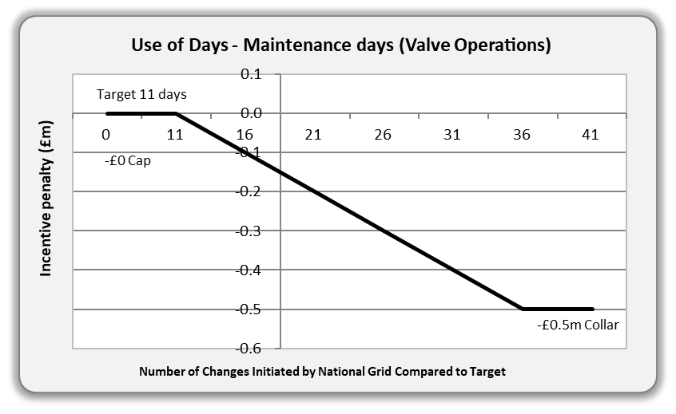
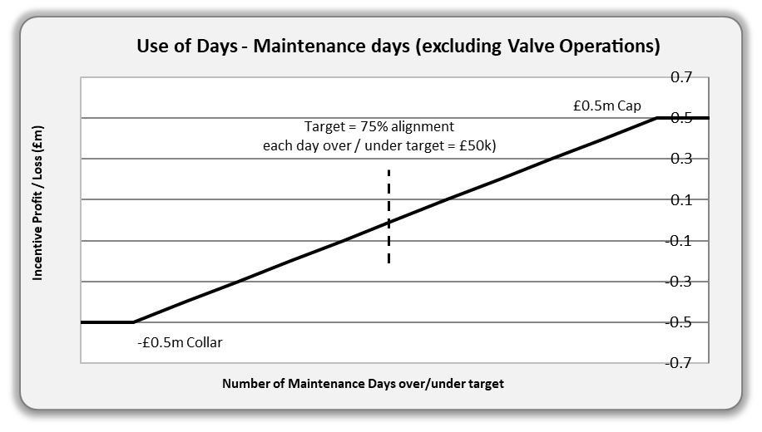
Maintenance (MA)
Scheme Parameters | Use of Days - Maintenance days (Valve Operations (VO))​ Target 11 days - Number of days used is equal to or less than target, revenue is zero.​ Number of days used exceeds the target, penalty of £20,000 per day up to £0.5m (for 25 days or more above target).​ Downside only: Cap £0m. Collar £0.5m. From the 12th day of change each day will result in an incentive charge of £20k up to day 36 at which point the maximum incentive loss will be realised.
Scheme Parameters | Use of Days - Maintenance days (excluding VO’s) ​ Align 75% of customer impacting work with customer outage on non-VO work.​ 75% x customer impacting days.​ Upside/Downside: Cap £0.5m. Collar £0.5m.​ This is a new element to the RIIO-2 scheme includes customer impacting aligned works and excludes NGG VO and Maintenance Days.

Slide 16
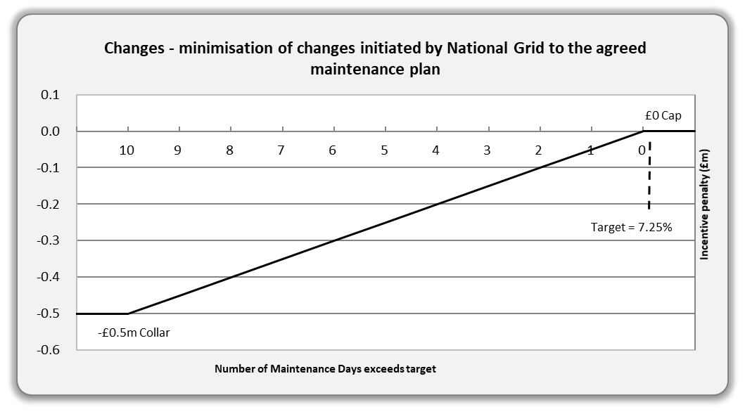
Maintenance (MA)
Scheme Parameters | Changes - minimisation of changes initiated by NGG to the agreed maintenance plan as published by 1st April in each year. Target 7.25% of the total maintenance plan days in the year. ​ Number of days changed is equal to or less than target, revenue is zero.​ Number of days changed exceeds the target, then a penalty of £50,000 per change more than the target is accrued to a scheme collar (10 changes or more).​ Downside only: Cap £0m, Collar -£0.5m.

Slide 17
Greenhouse Gas Emissions (GHG)
Purpose | The aim of the Greenhouse Gas Emissions (GHG) incentive scheme is to reduce the effect of our operational activities on the environment. This is important both to us, our customers and stakeholders and society. The scheme incentivises NGG to make the trade-off between choosing to depressurise compressor units (venting the gas - primarily methane) or to keep units on standby, which incurs costs associated with ancillary electrical equipment (vent fans, oil pumps etc.) and a level of emissions through the shaft seal. The incentive applies to both gas and electrically driven compressors.
Description | Compressors are used to increase pressure in parts of the NTS and to move gas from the sources of supply to areas of demand. To undertake this activity to deliver customer requirements, we will select the Best Available Technology (BAT) in accordance with the Industrial Emissions Directive (IED). The need to operate an individual compressor on any given day depends on several factors, including the sources of supply and demand, the prevailing network conditions, and the need to accommodate essential maintenance, emissions testing and construction plans. Natural gas vented from NTS compressors results from a number of activities; Starting a compressor, Depressurising a compressor, Purging a compressor, and the leakage of gas through a seal around the shaft of a compressor.
Benefits | Improved local air quality. Optimise compressors - ensuring compressor standby time is optimised against cost of venting or costs associated with ancillary electrical equipment. The calculation methodology is externally audited on an annual basis.

Slide 18
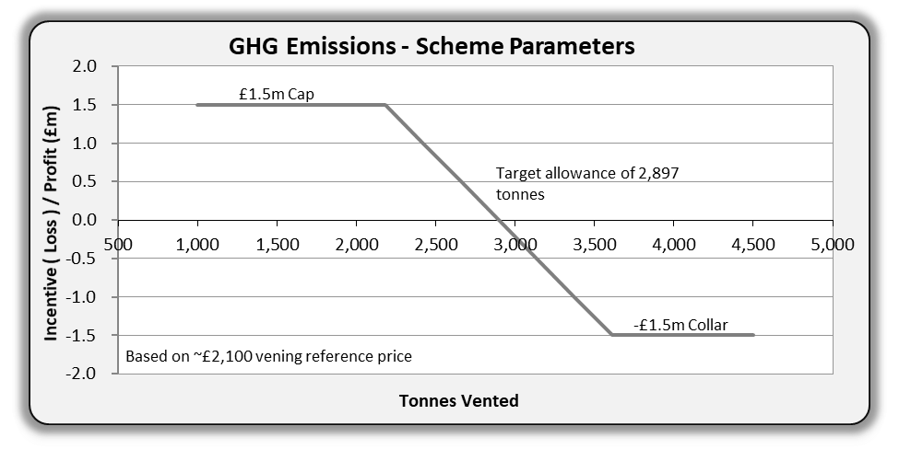
Greenhouse Gas Emissions (GHG)
Scheme Parameters | The emissions allowance under this incentive is set by Ofgem, our allowance for each year of the RIIO-2 period is 2,897 tonnes.
Description | For each tonne of natural gas vented over the allowance we are subject to a venting reference price payment, which is based on our NTS GT Licence formula using the latest non-traded carbon reference venting price published by The Department for Business, Energy and Industrial Strategy.

Slide 19
Associated Reading
National Grid Gas plc Gas Transporter Licence. Special Conditions Special Condition 5.6 System operator external incentives, revenues and costs (SOIRCt)
https://epr.ofgem.gov.uk/Content/Documents/National%20Grid%20Gas%20Plc%20-%20Special%20Conditions%20Consolidated%20-%20Current%20Version.pdf
System Management Principles Statement (SMPS)
https://www.nationalgrid.com/uk/gas-transmission/about-us/how-were-regulated/gas-industry-compliance
^{Procurement Guidelines Report}
https://www.nationalgrid.com/gas-transmission/about-us/how-were-regulated/gas-industry-compliance
Uniform Network Code – Transportation Principal Document Section L – Maintenance and Operational Planning
https://www.gasgovernance.co.uk/sites/default/files/ggf/page/2022-05/14%20TPD%20Section%20L%20-%20Maintenance%20and%20Operational%20Planning.pdf

Slide 20
Version Control
Version Number | Date of Publication | Changes Made
1.0 | October 2022 | RIIO-2 First Issue
For further details
Further details on each incentive can be found here: https://www.nationalgrid.com/uk/gas-transmission/about-us/system-operator-incentives
Or contact chris.hewitt@nationalgrid.com, Incentive Development Team.

